Slide 1
GREAT OUTDOORS
TEAM - A

Slide 2
TEAM A
Madhuri Vemulapaty
Ankush Agrawal
Shreyash Pandey
Sourav Maji
Sarthak Lav

Slide 3
Use Case Diagrams

Slide 4
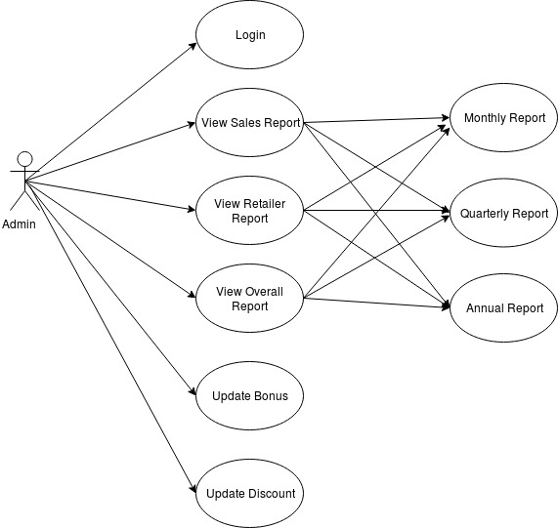
Use Case Diagram - Admin

Slide 5
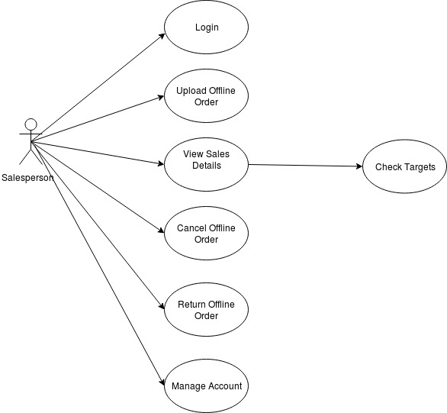
Use Case Diagram – Salesperson

Slide 6
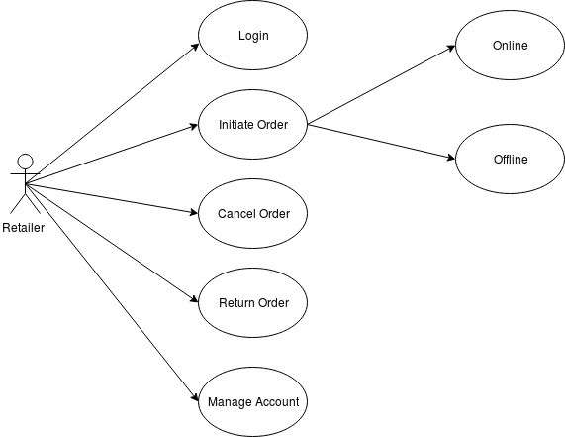
Use Case Diagram - Retailer

Slide 7
ER Diagram

Slide 8
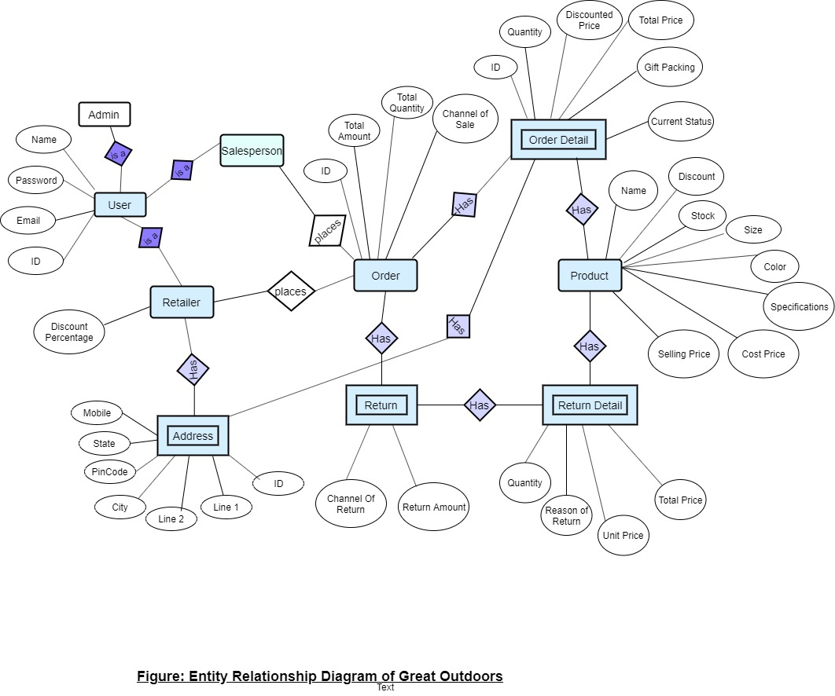

Slide 9
Salesperson and Product

Slide 10
EPIC – Salesman should upload offline orders
User Stories:
Salesman should be able to upload order details like product ID, name and quantity along with discount and total price.
Salesman should be able to view uploaded sales.

Slide 11
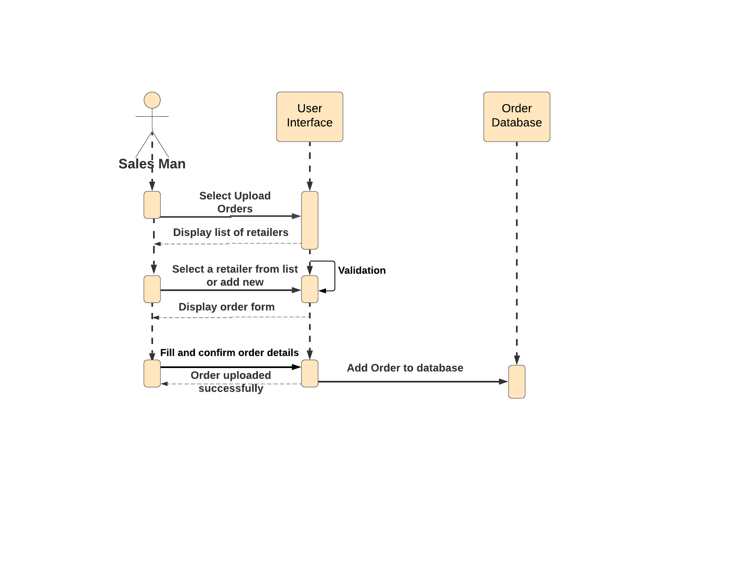
Sequence diagram to upload offline order

Slide 12
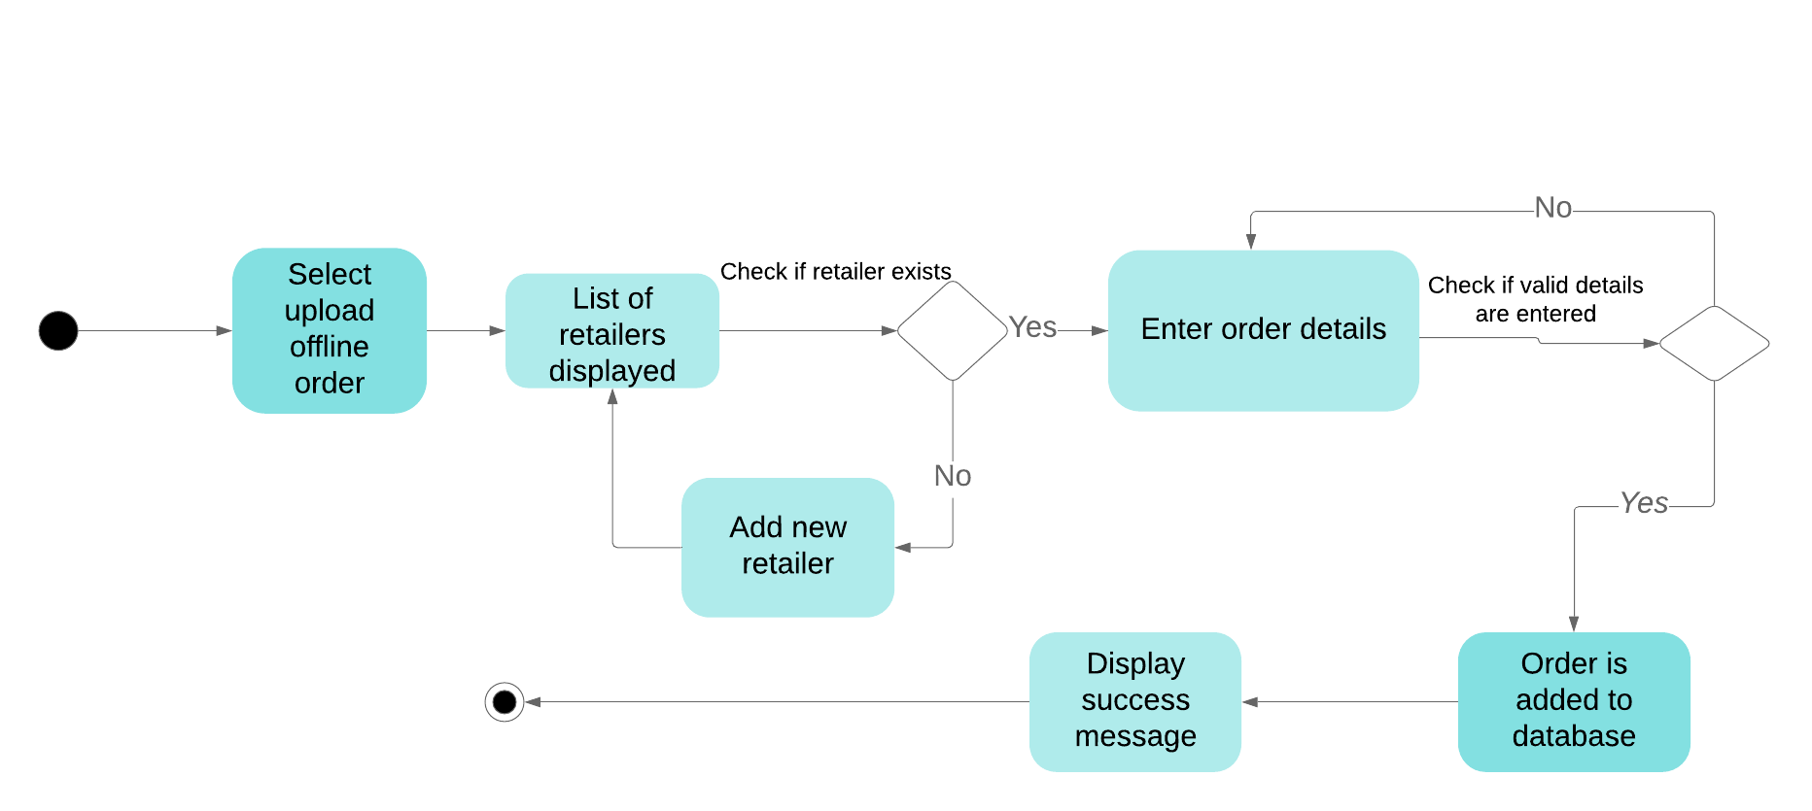
Activity diagram to upload offline order

Slide 13
EPIC – Admin should add, update and delete products
User Stories:
Admin should be able to add products to the database and view the existing products.
Admin should be able to edit product details like – price, discount etc.
Admin should be able to delete products from database.

Slide 14
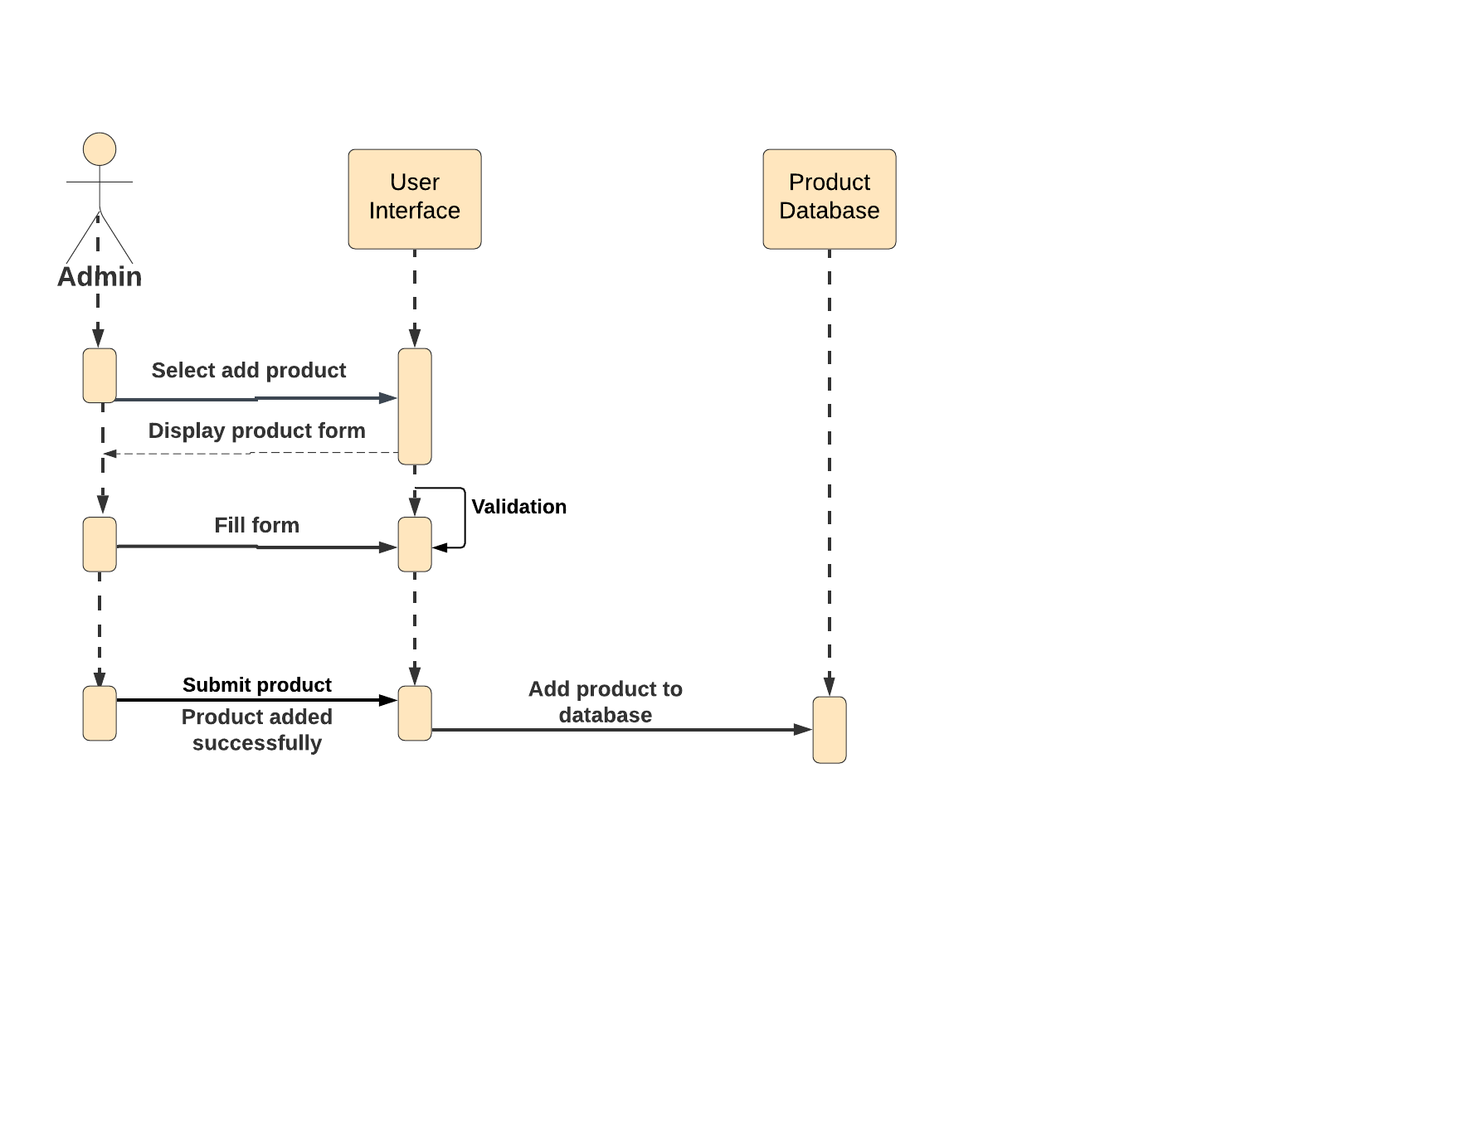
Sequence diagram to add product

Slide 15
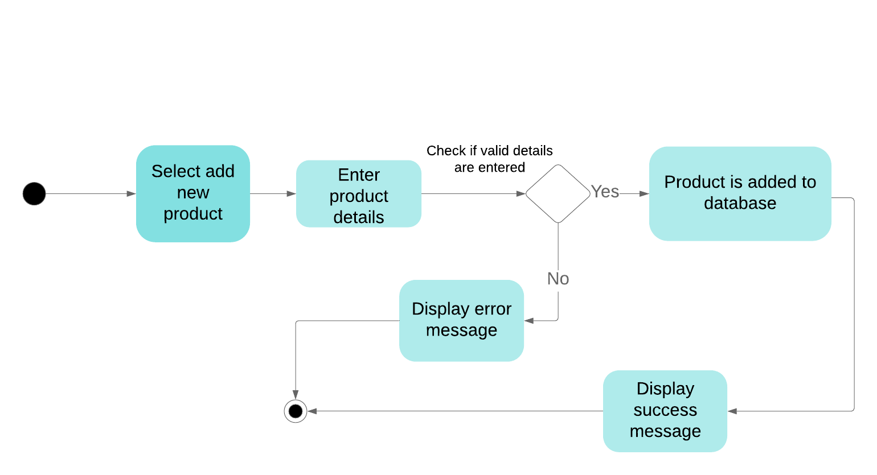
Activity diagram to add product

Slide 16
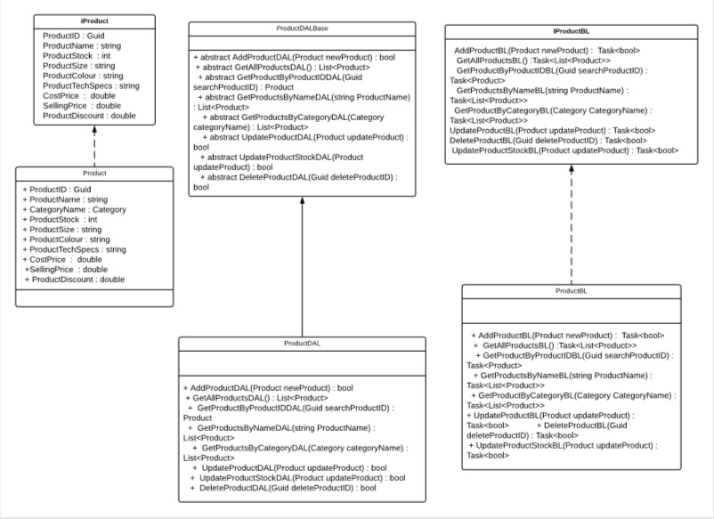

Slide 17
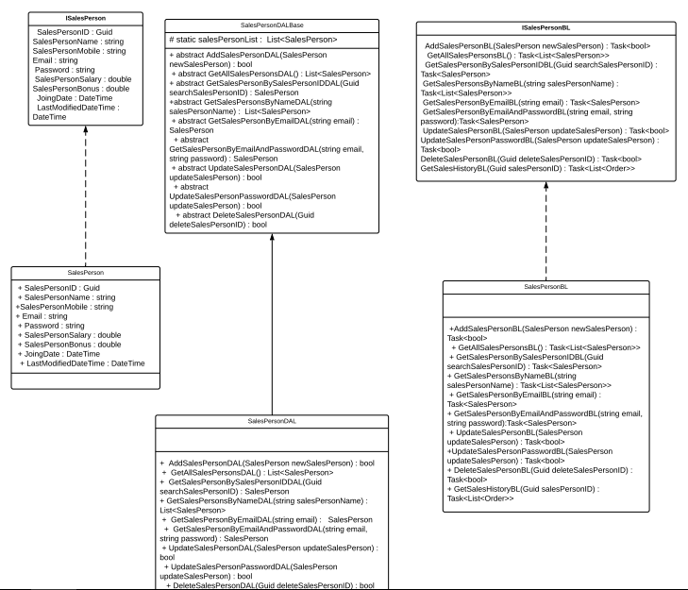

Slide 18
Admin and Address

Slide 19
EPIC – Retailer should add, update and delete addresses
User Stories:
Retailer should be able to view existing addresses.
Admin should be able to update addresses.
Admin should be able to delete addresses.

Slide 20
EPIC – Retailer should add, update and delete addresses
User Stories:
Retailer should be able to view existing addresses.
Admin should be able to update addresses.
Admin should be able to delete addresses.

Slide 21
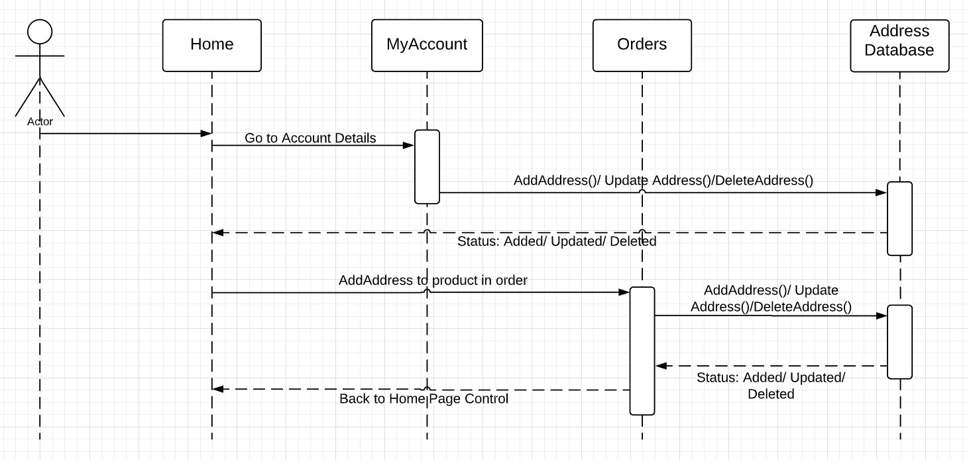
Sequence Diagram to add new address

Slide 22
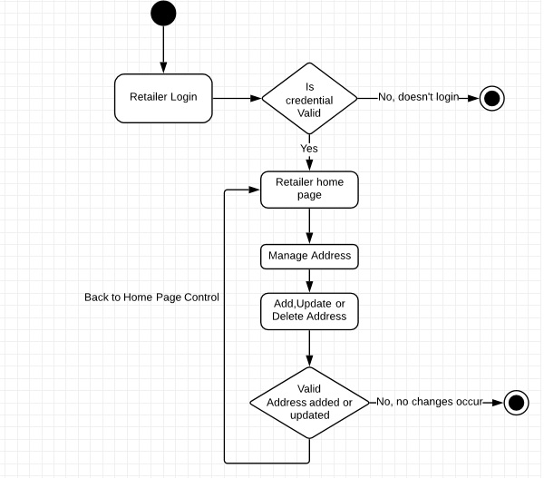
Activity Diagram to add new address

Slide 23
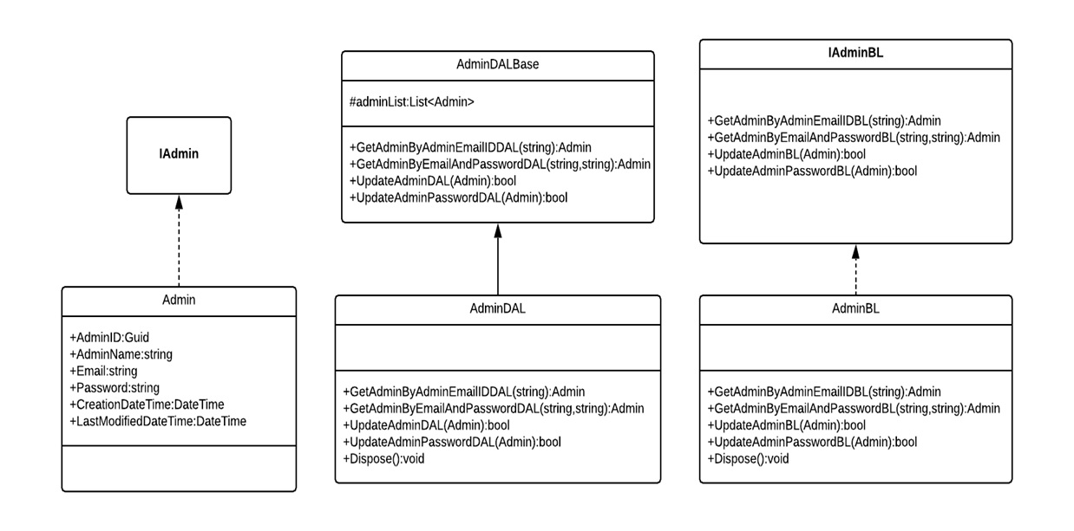

Slide 24
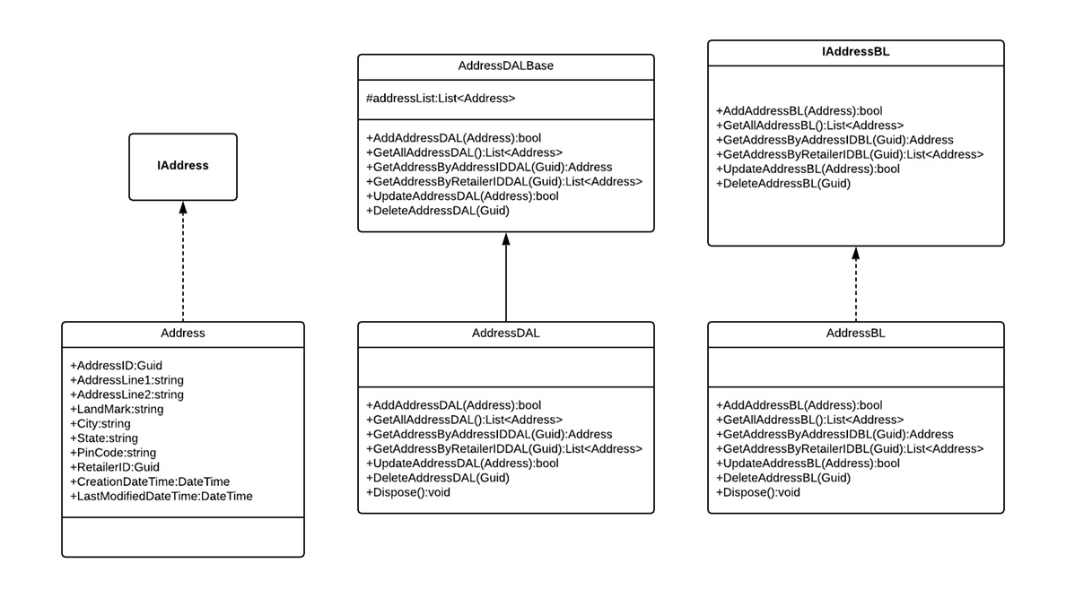

Slide 25
Return and Cancel

Slide 26
EPIC – Retailer should be able to return order
User Stories:
Retailer should be able to view order history.
Retailer should be able to select a product for return.
Return status should be displayed after returning.

Slide 27
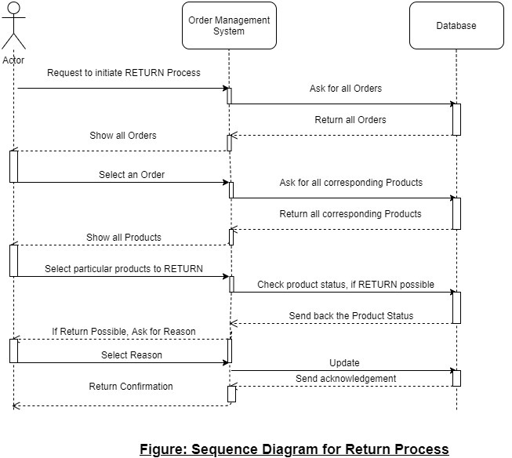
Sequence diagram for return order

Slide 28
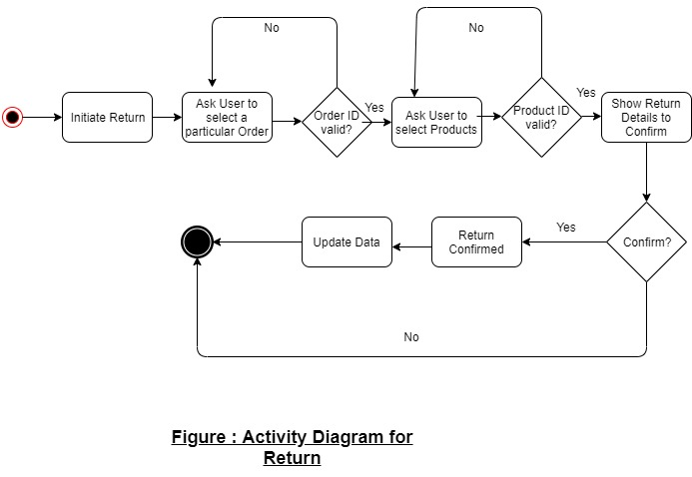
Activity Diagram to Return Order

Slide 29
EPIC – Retailer should be able to cancel order
User Stories:
Retailer should be able to view order history.
Retailer should be able to select a product for cancellation.
Order status should be displayed after cancellation.

Slide 30
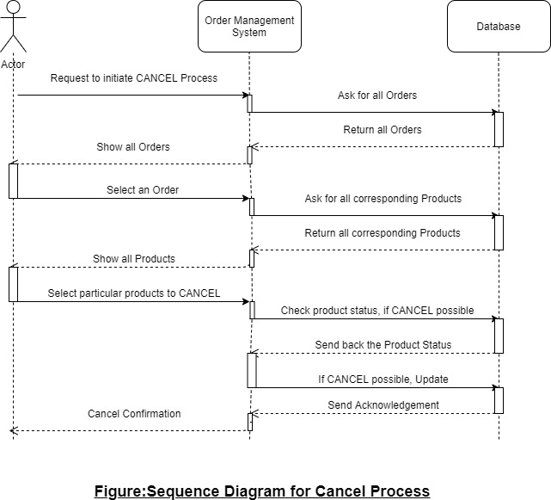
Sequence diagram to cancel order

Slide 31
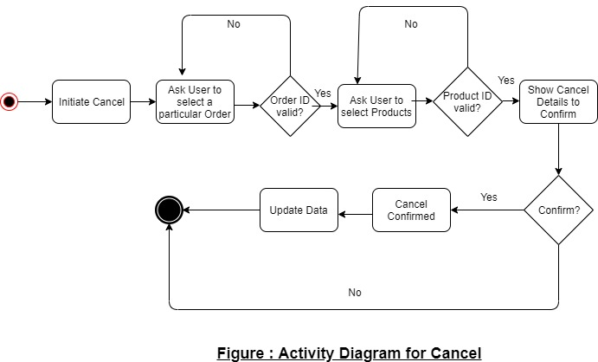

Slide 32
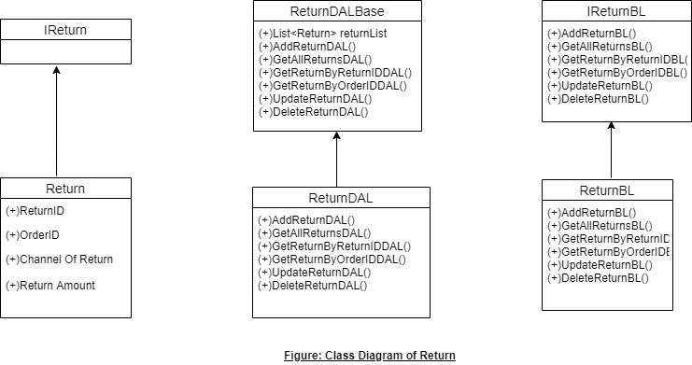
Class Diagram - Return

Slide 33
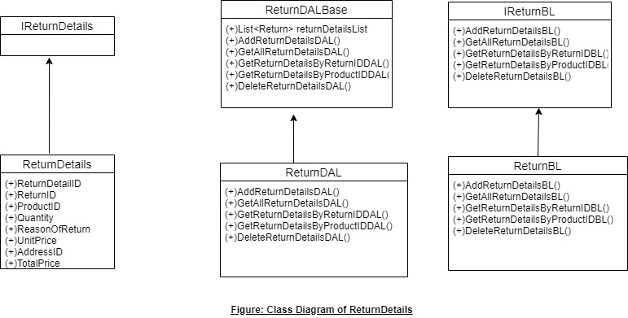

Slide 34
Retailer

Slide 35
EPIC – Retailer should be able to update details
User Stories:
Retailer should be able to view his/her profile
Retailer should be able to edit his/her details.
Edited profile should then be displayed.

Slide 36
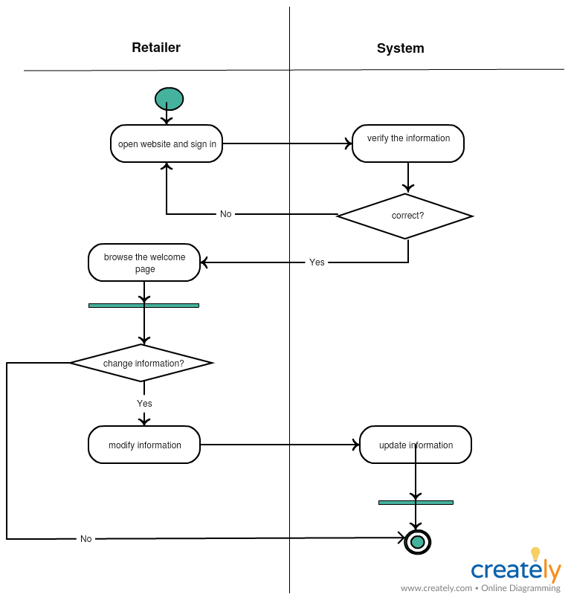
Activity diagram to update retailer

Slide 37
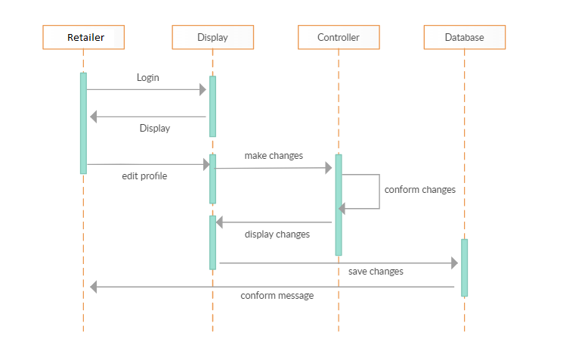
Sequence diagram to update retailer

Slide 38
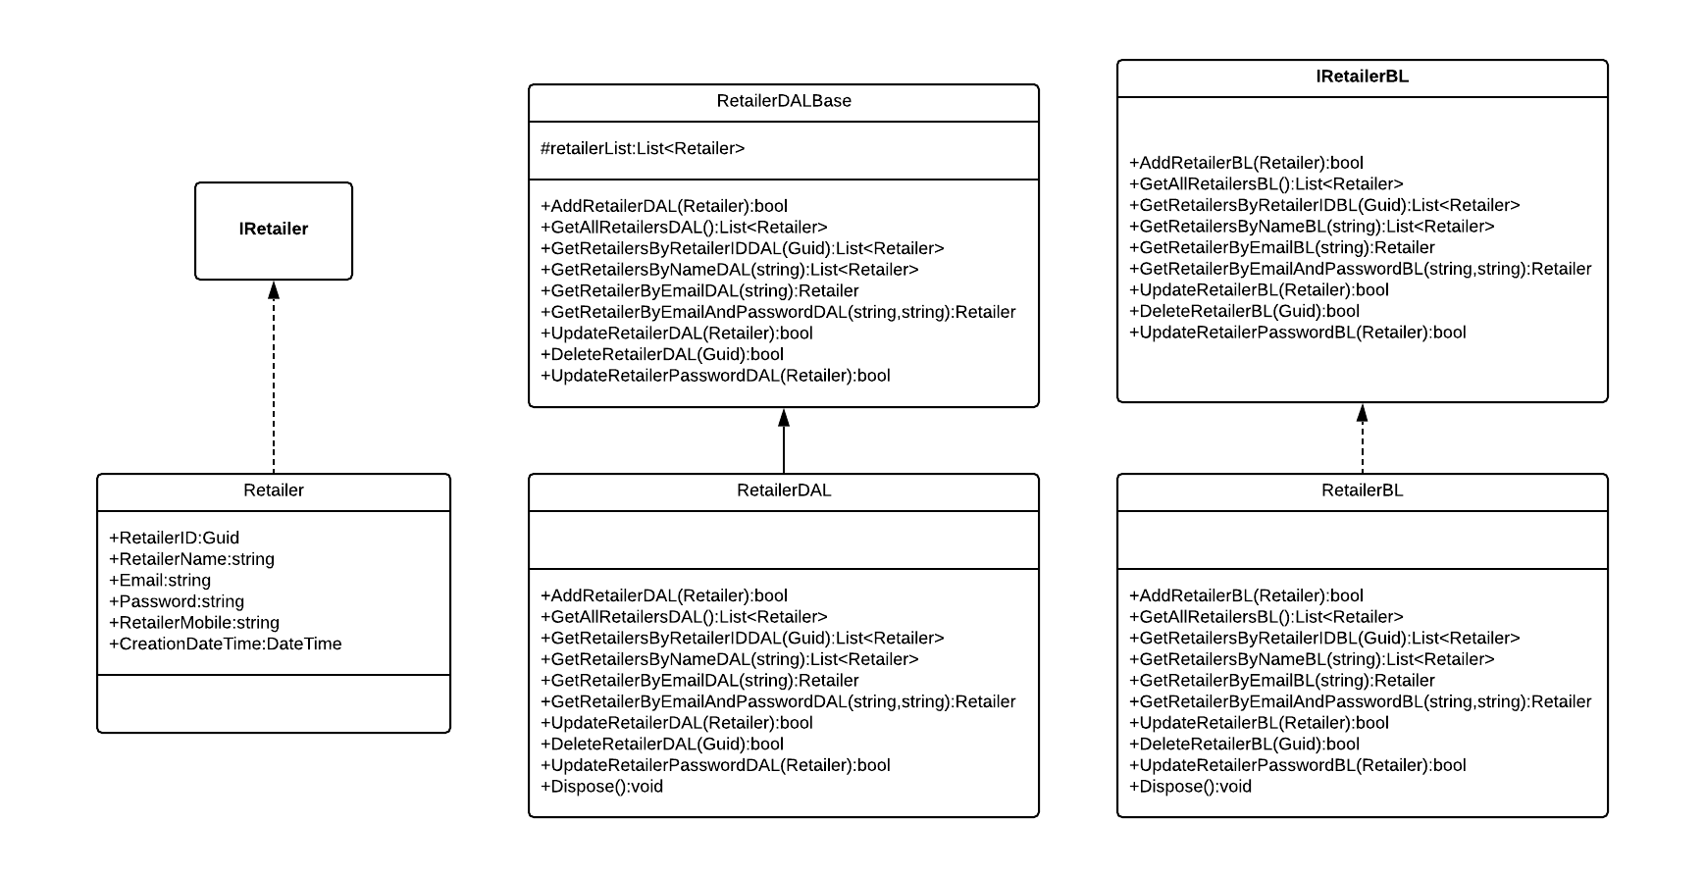

Slide 39
Order and Order Details

Slide 40
EPIC – Retailer should be able to place order
User Stories:
Retailer should be able to view products by category
Retailer should be able to add product to cart after viewing details and changing quantity.
Retailer should be able to select address for each product.

Slide 41
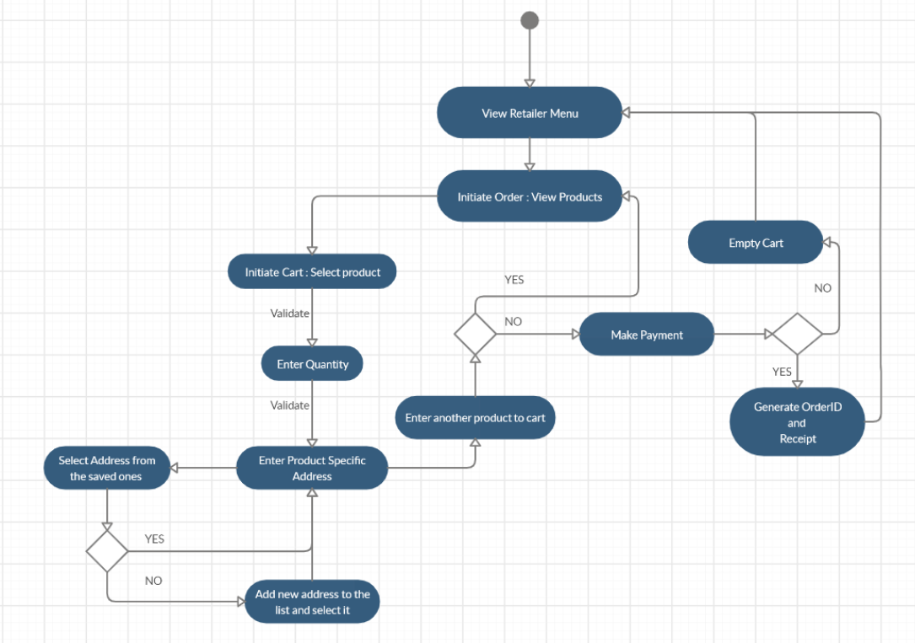
Activity diagram to place order

Slide 42
